Slide 1
Stack Overflow Analysis using AWS and Apache Spark
Team member's
Koushik Modekurti
Rithwik Maramraju
Swathi Kasarabada
Teja Sree Bussa

Slide 2
Agenda
Introduction
Dataset details
Project Architecture
Components List
Data Preprocessing
Data Transformation
Dara Analysis
Conclusion

Slide 3
Introduction
Stack Overflow is a popular question and answer community website for developers. It was launched in 2008 and has since become one of the most widely used platforms for programmers to ask and answer technical questions related to software development.
Stack Overflow is a user-driven platform where members can ask questions, provide answers, and vote on the best answers.
The site covers a wide range of programming topics, including languages like Python, Java, and JavaScript, as well as web development frameworks, databases, and more.
Overall, Stack Overflow has become an invaluable resource for developers seeking help and information on a wide range of technical topics.
The goal of this project is to learn more about user behavior and community activity on Stack Overflow, one of the most active programming forums online.

Slide 4
Dataset details
Stack Overflow dataset contains information about the questions asked on the Stack Overflow platform, including the title of the question, the body of the question, the user who asked the question, the date and time the question was asked, and the tags associated with the question.
Additionally, the dataset also includes information about the answers provided by other users, including the answer body, the user who provided the answer, the date and time the answer was provided, and the score of the answer.
The data is available in a compressed XML format and can be downloaded from the Stack Exchange Data Dump archive.
Data set Link: stackexchange directory listing (archive.org)
Dataset size is around 98GB.

Slide 5
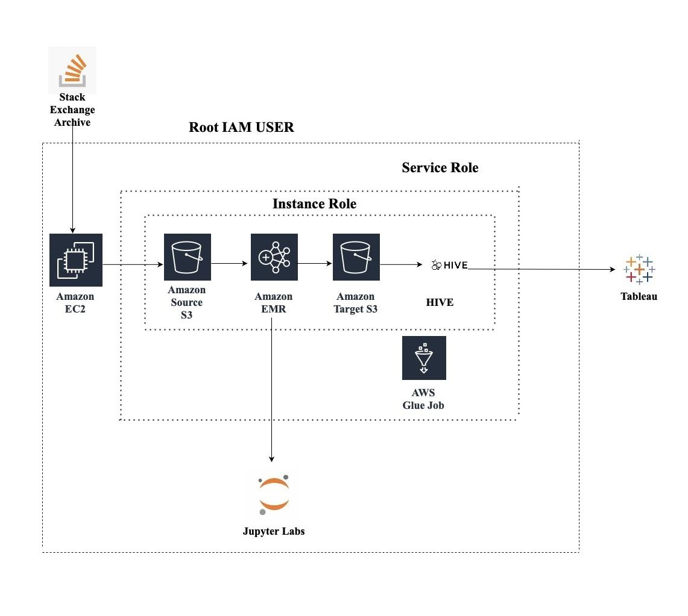
Project Architecture

Slide 6
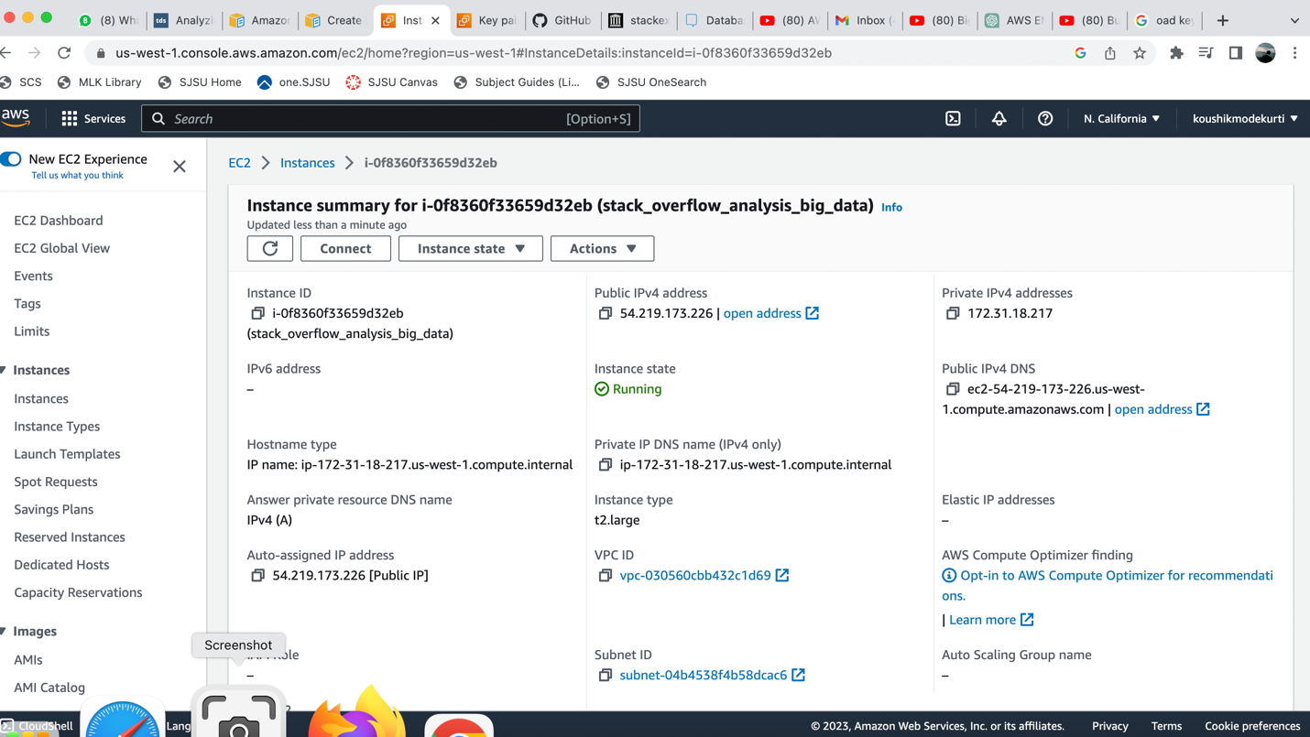
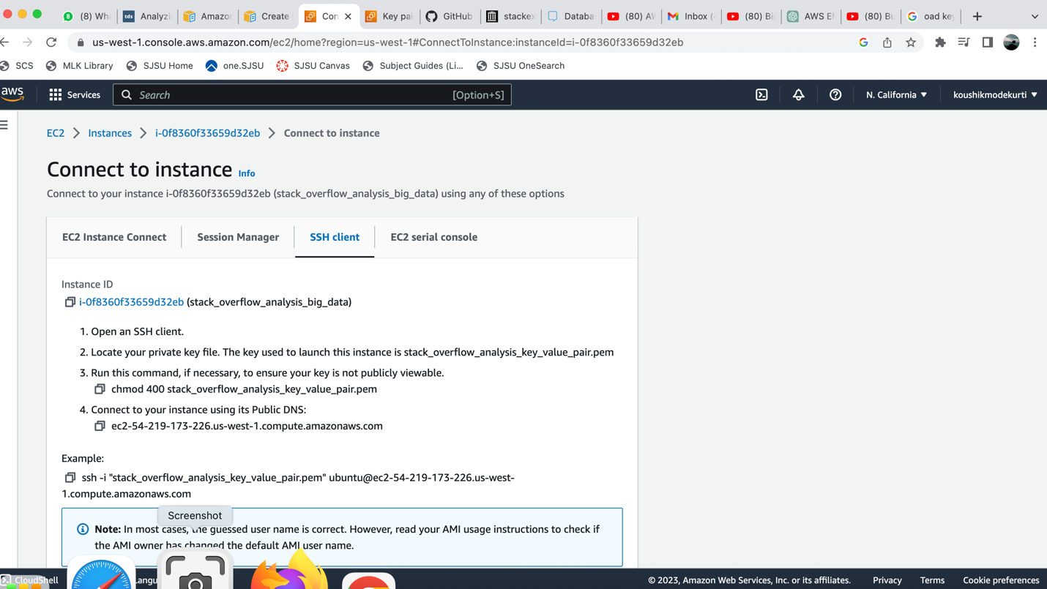
EC2-Instance creation
EC2 Instance Creation: Creating an EC2 instance with
Ubuntu operating system
Connecting to EC2 Instance using SSH Client:

Slide 7

Data Retrieving from the website
Connecting with Local Terminal using SSH Protocol
Extracting the stack overflow data from this link: 'https://archive.org/download/stackexchange/stackoverflow.com-Posts.7z’ in a compressed format.
Once the data is downloaded (19 GB), decompress it using 7 zip to retrieve 95 GB of data, with the command
7z x /home/ubuntu/posts.7z

Slide 8
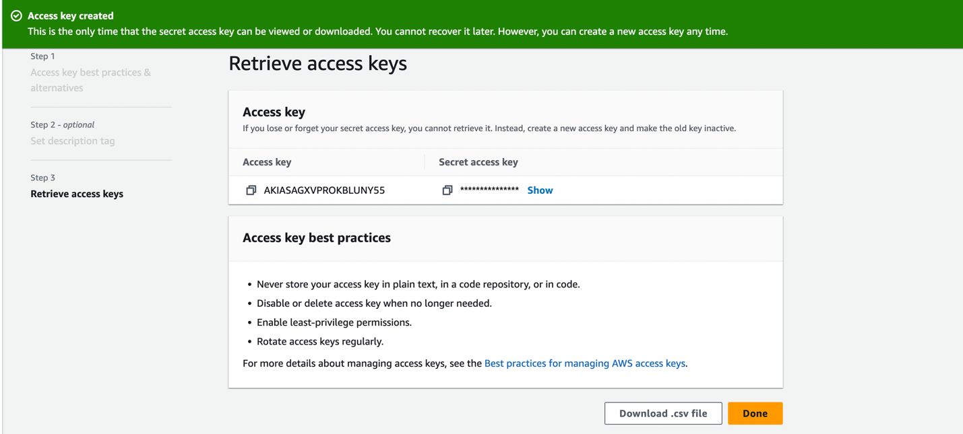
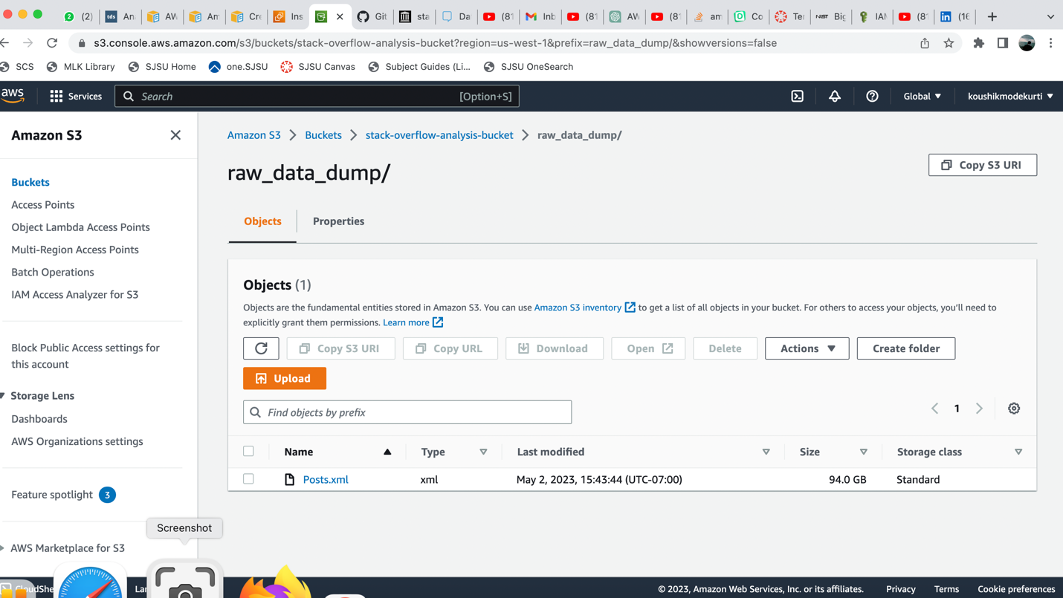
Data Storage – S3 bucket
Create a User and then Create Access key in the
Security Credentials Section of the user.
Creating an S3 Bucket to load data from EC2 to S3:

Slide 9
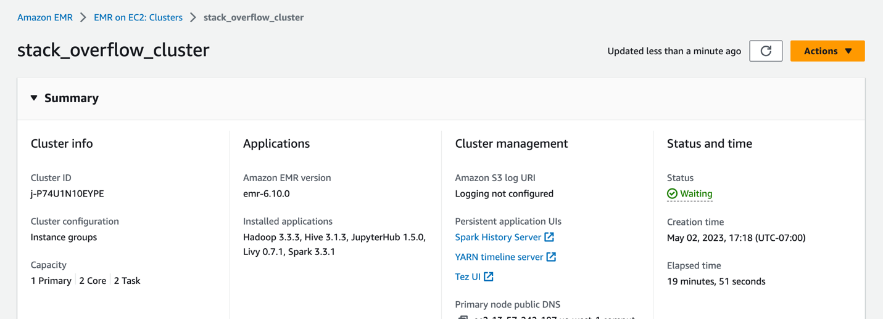
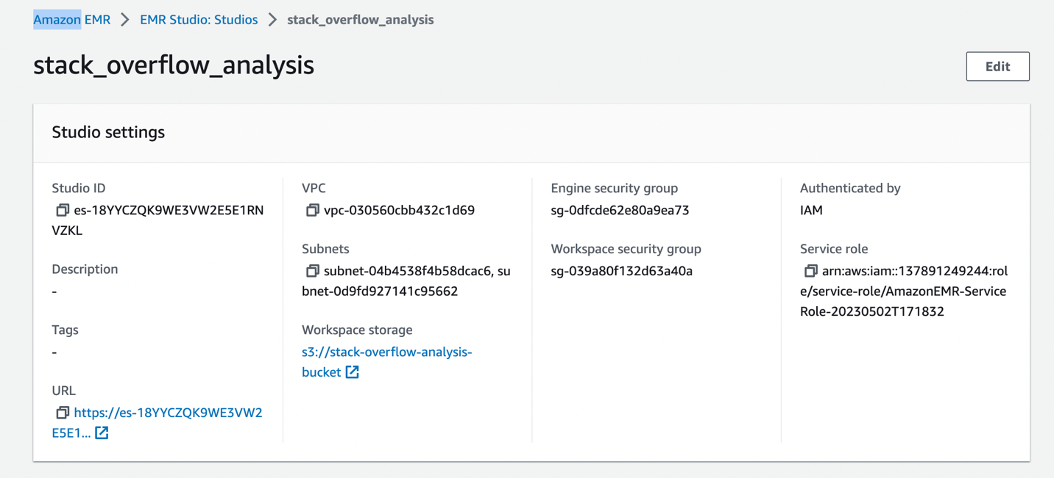
EMR-Cluster
Stack_overflow_cluster cluster is created, Cluster was
specified with 1 primary node, 2 task nodes and
2 core nodes and also on these nodes Jupyter notebook,
Hadoop, Spark,hive and Levi were installed.
Create EMR Studio :

Slide 10
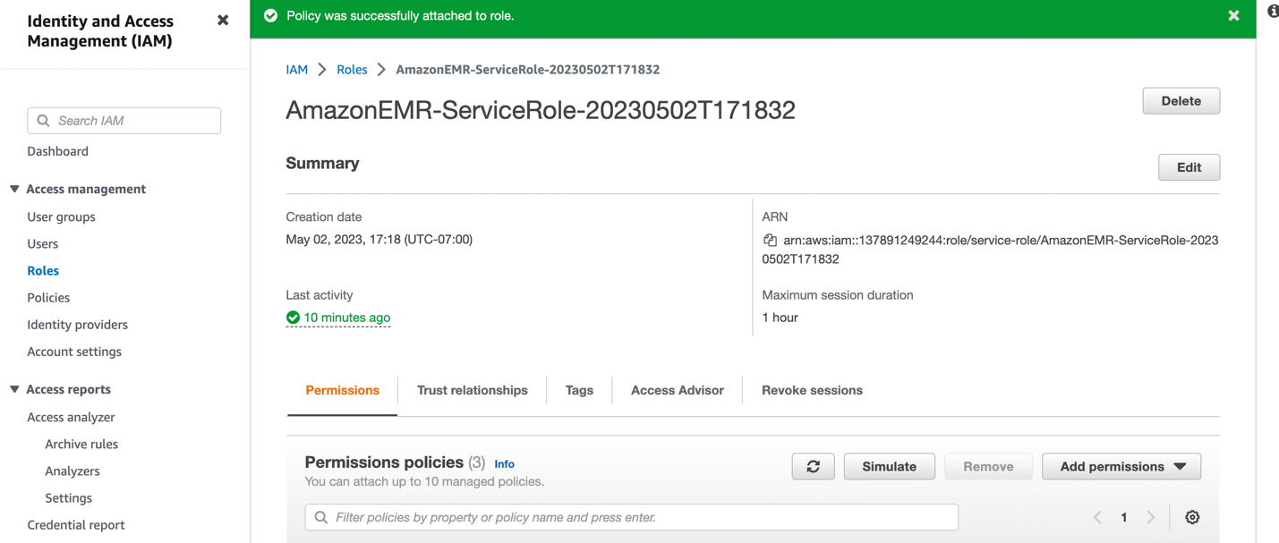
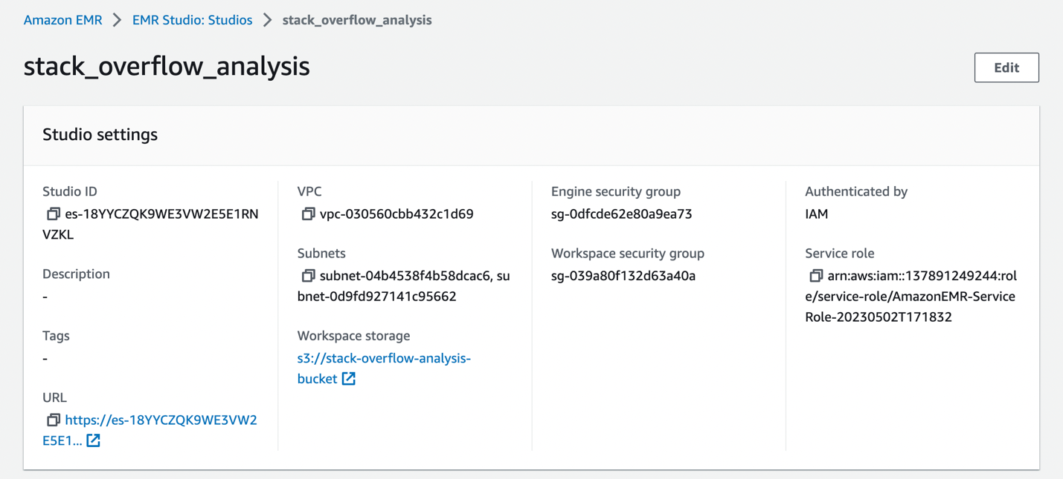
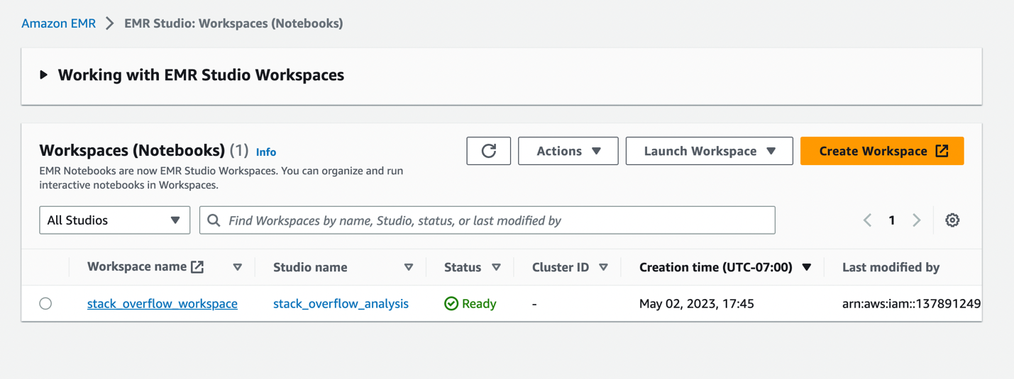
EMR-Cluster
We encounter Servicerole error, so in the IAM Roles,
add PowerUserAccess to the service role created
while creating AWS EMR Cluster.
Creating an Workstudio first to create workspace:

Slide 11
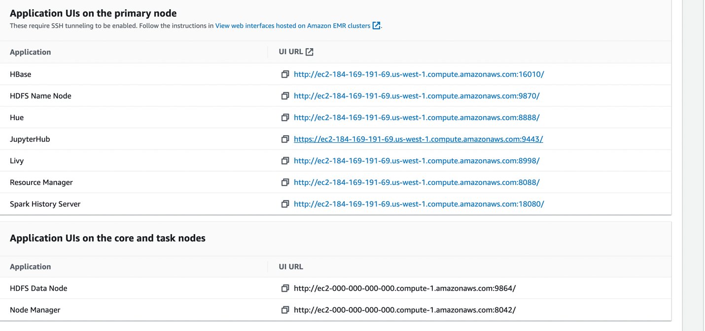
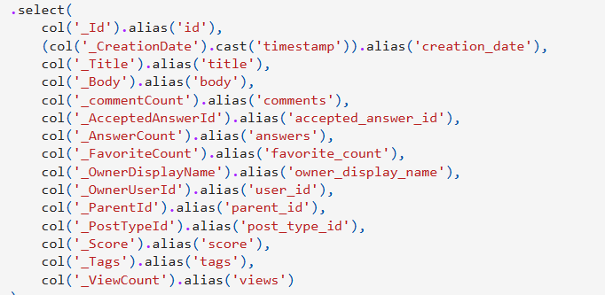
Data Preprocessing:
Data Pre-processing steps performed in EMR Studio Workspace.
Data Preprocessing steps: Changing the column names.

Slide 12
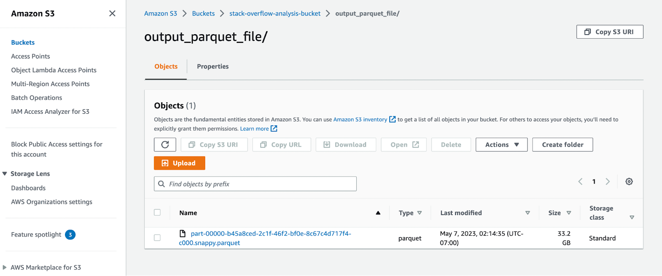
Data Transformation
Changing the data from XML to Apache Parquet, which is very convenient to perform data analysis in Spark.
Processed and Transformed Parquet File in S3 Bucket (output_parquet_file directory)

Slide 13
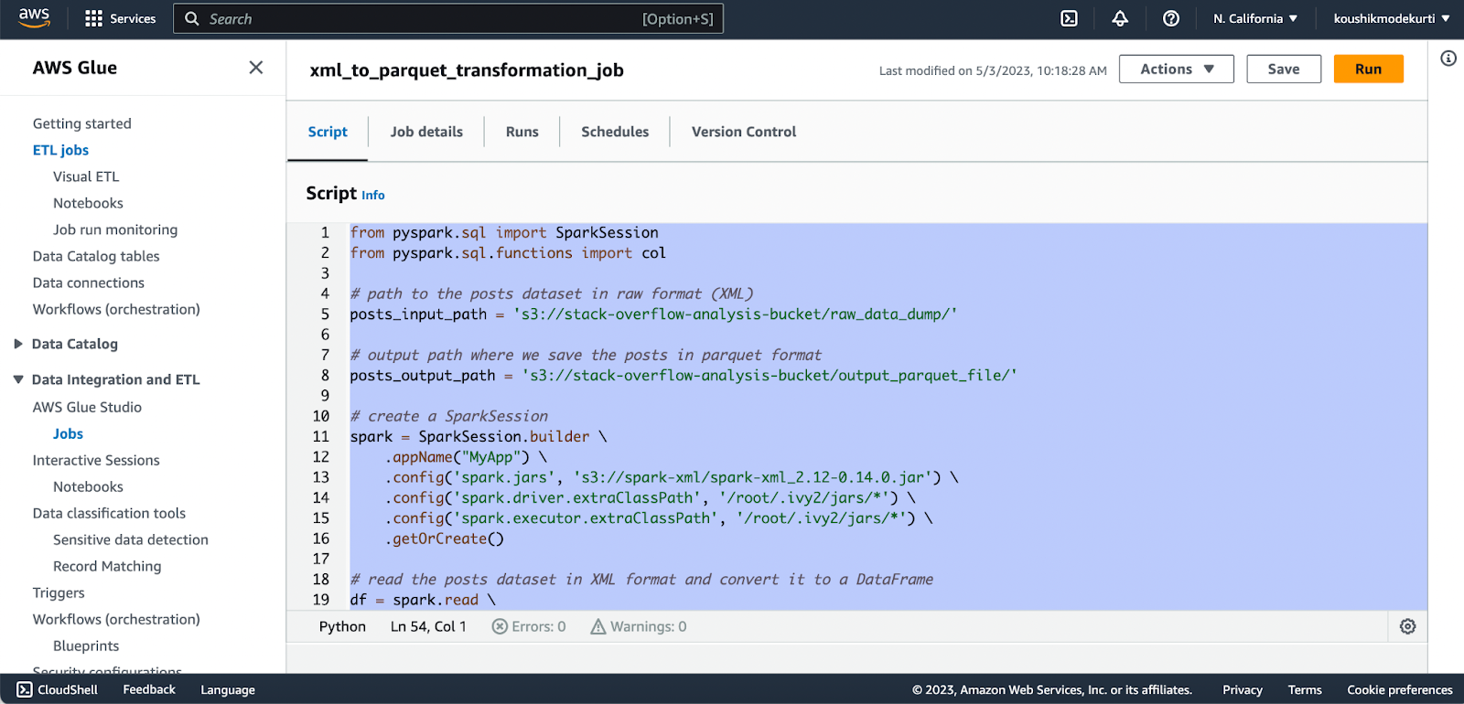
Automation Task Details:
Automation with AWS Glue : Pre-processing & XML to Parquet Transformation

Slide 14
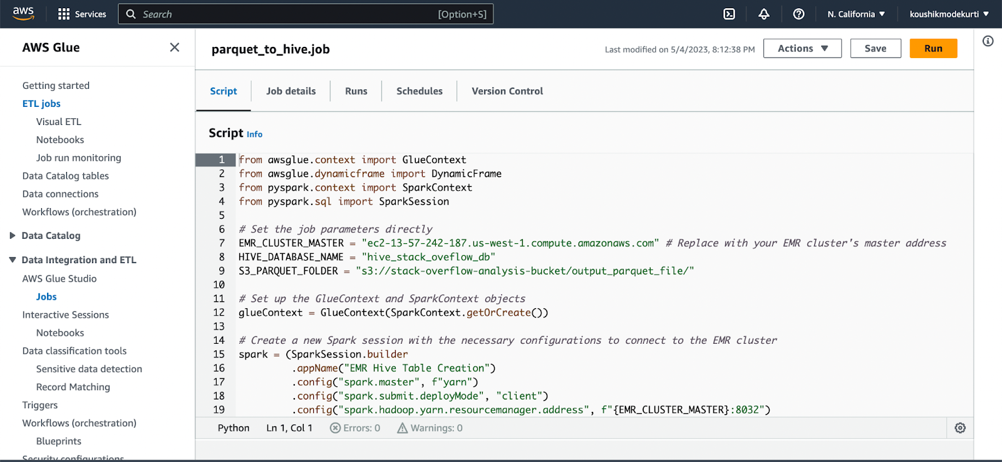
Automation Task Details:
Automation with AWS Glue (Parquet to Hive):

Slide 15
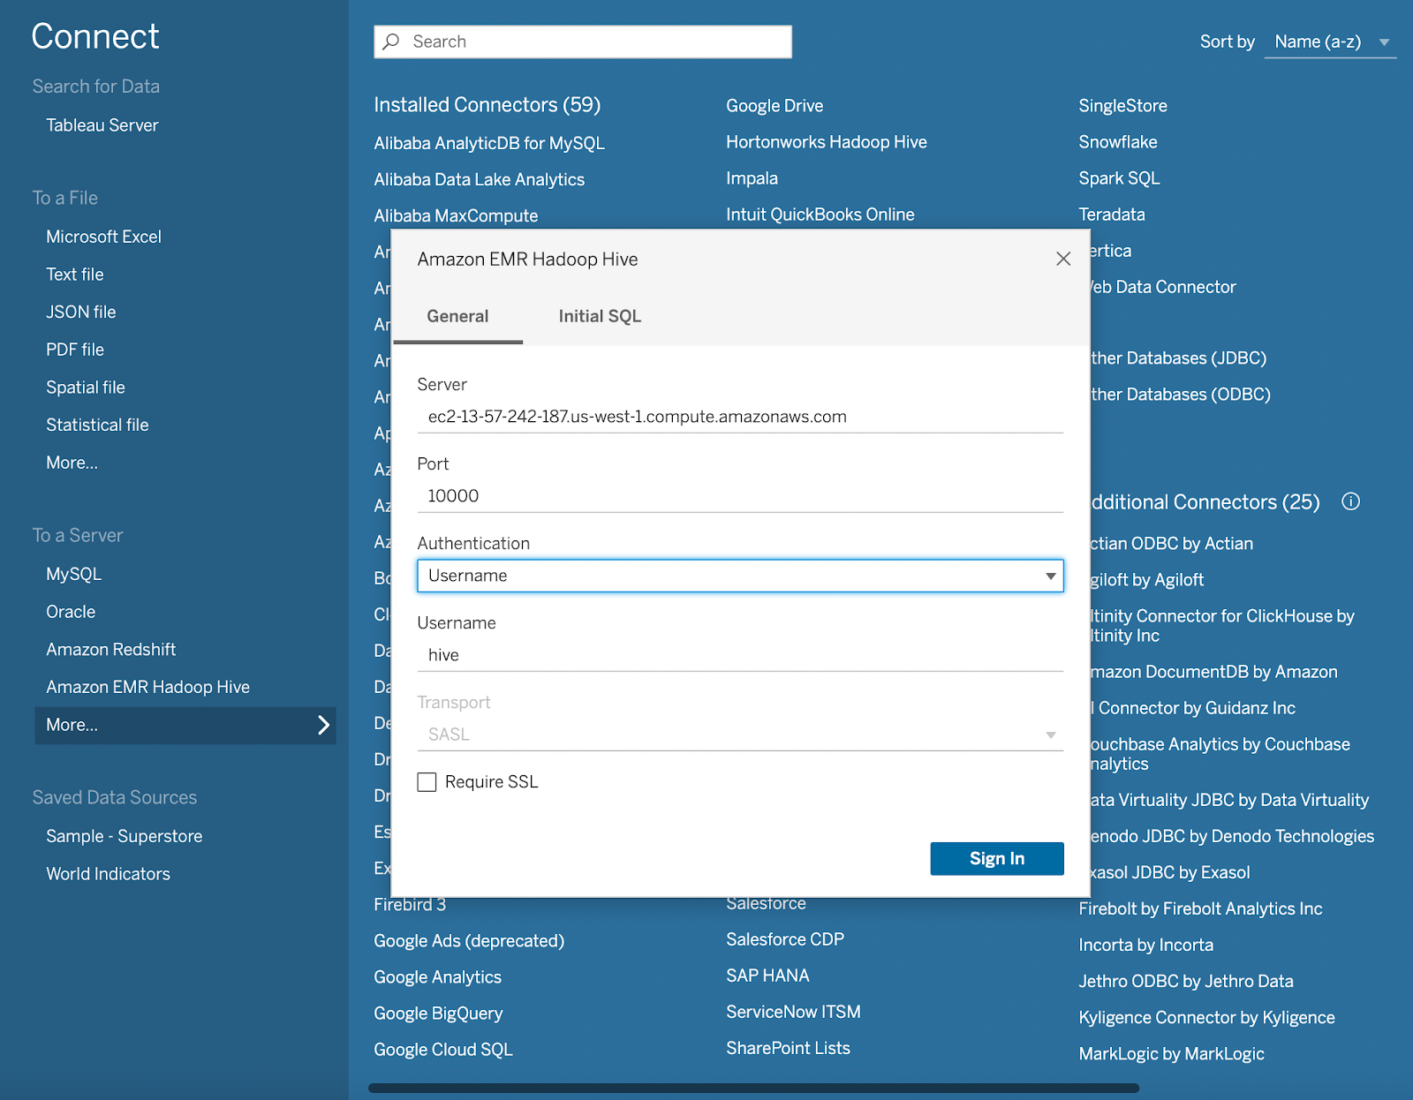
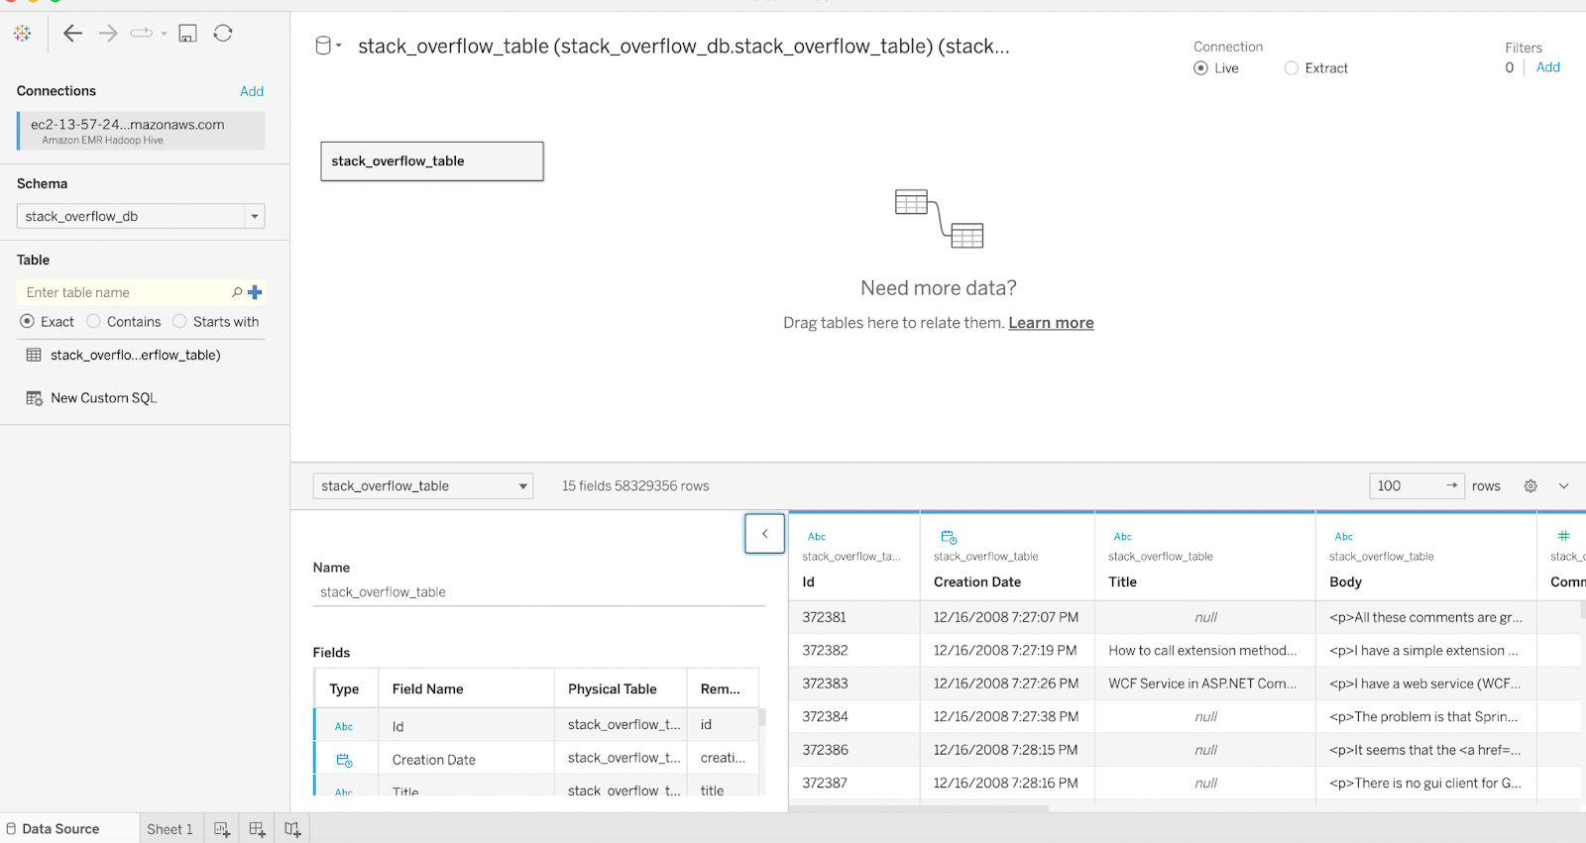
Data Analysis
Hive Connection with Tableau

Slide 16
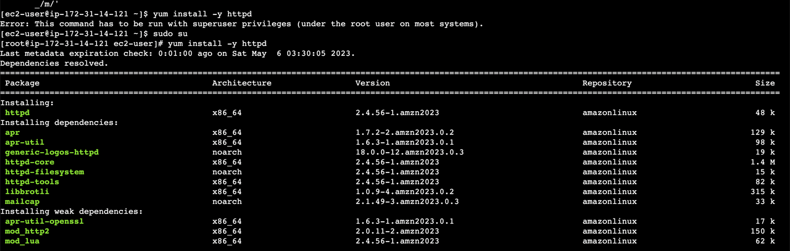

Web Server Creation Details:
Installation of Apache Web Server:
Checking status of Web Server

Slide 17
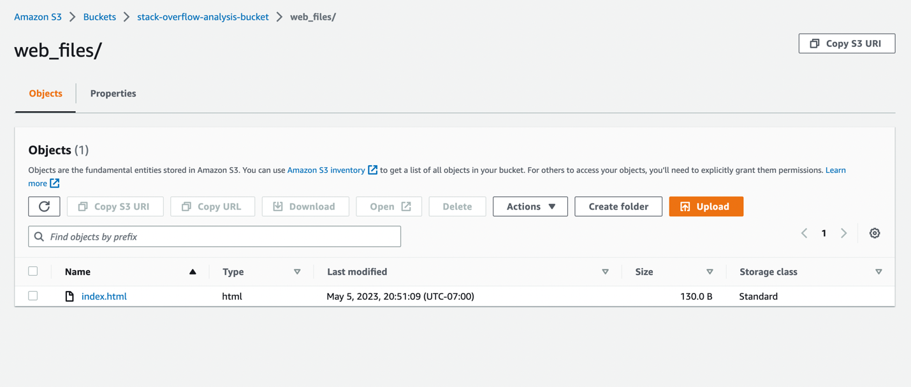
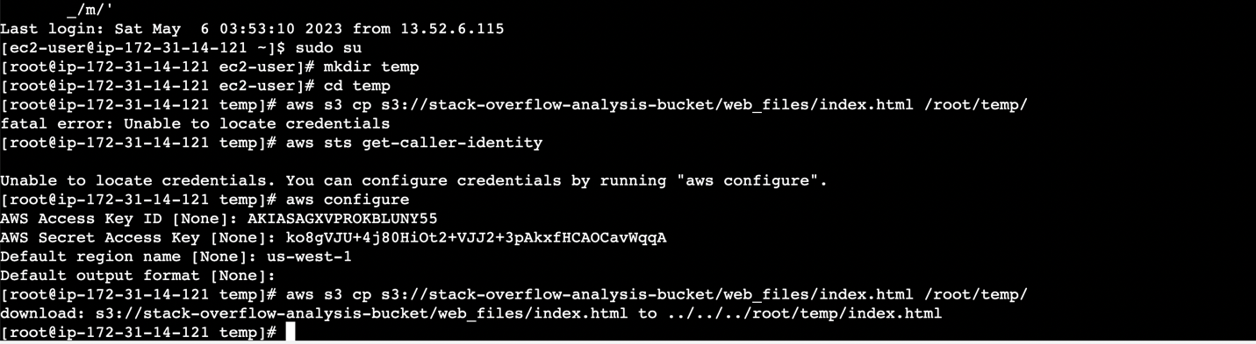
Create index.html and place it in bucket
Copy S3 Bucket index file to Apache Web Server

Slide 18
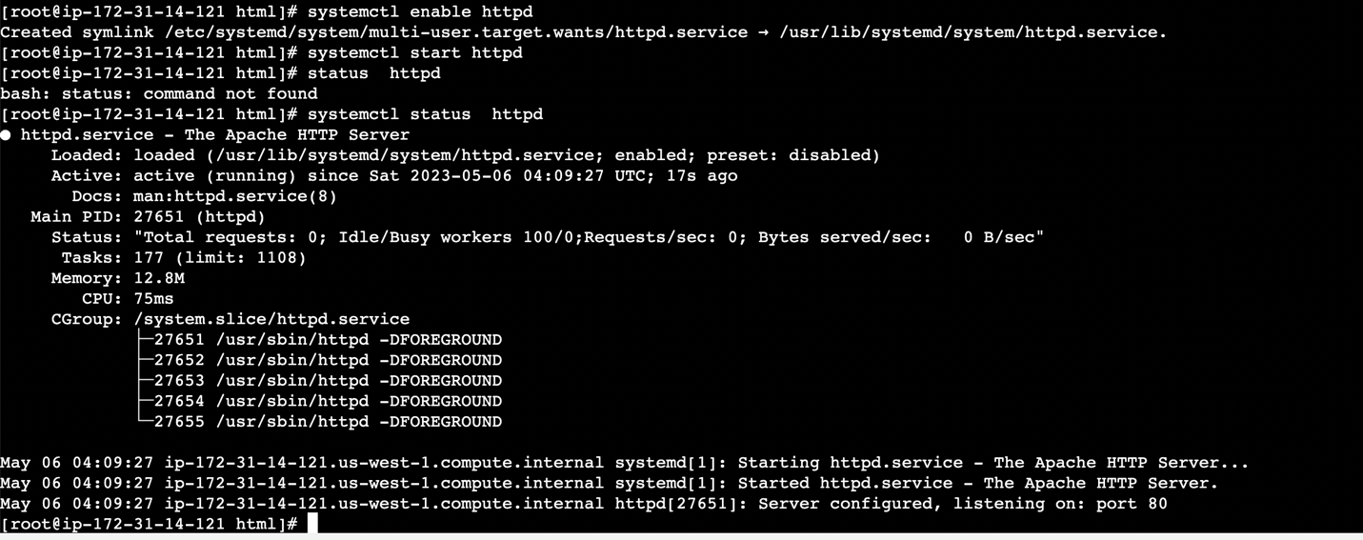
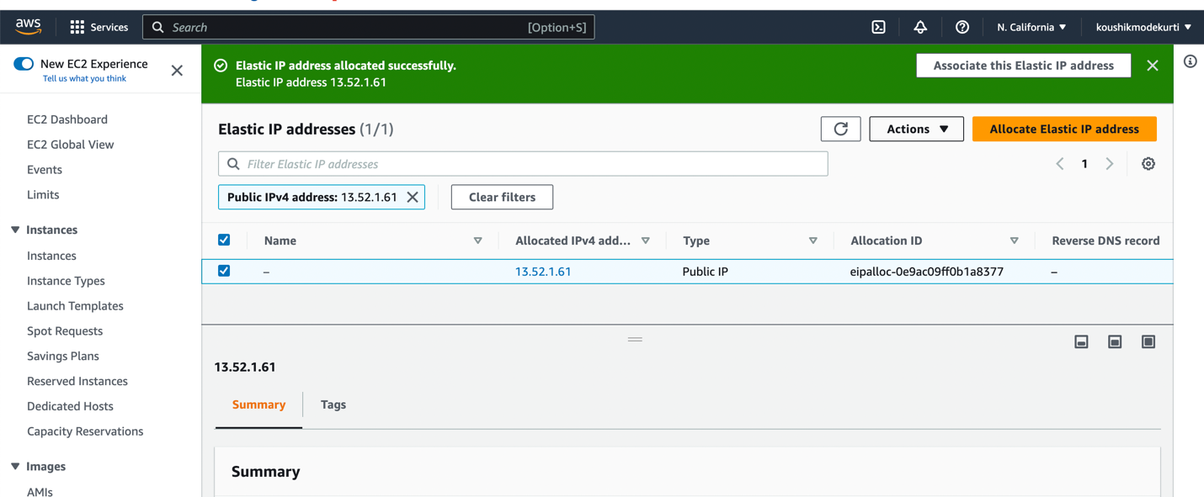
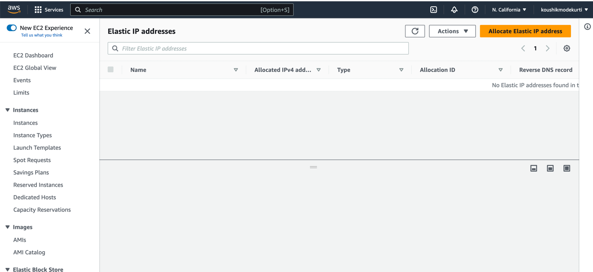
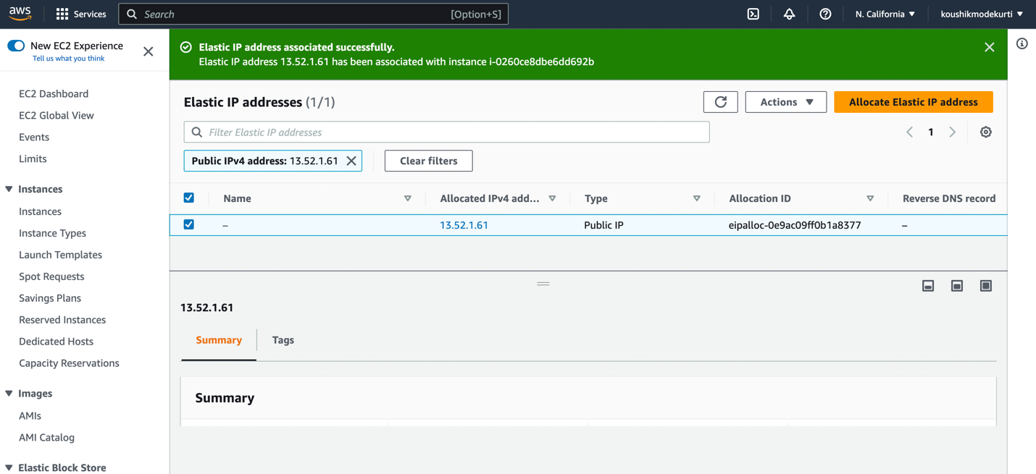
Starting Apache Web Server:
Allocate Elastic Ips - Associate and Allocating Elastic IP Address

Slide 19
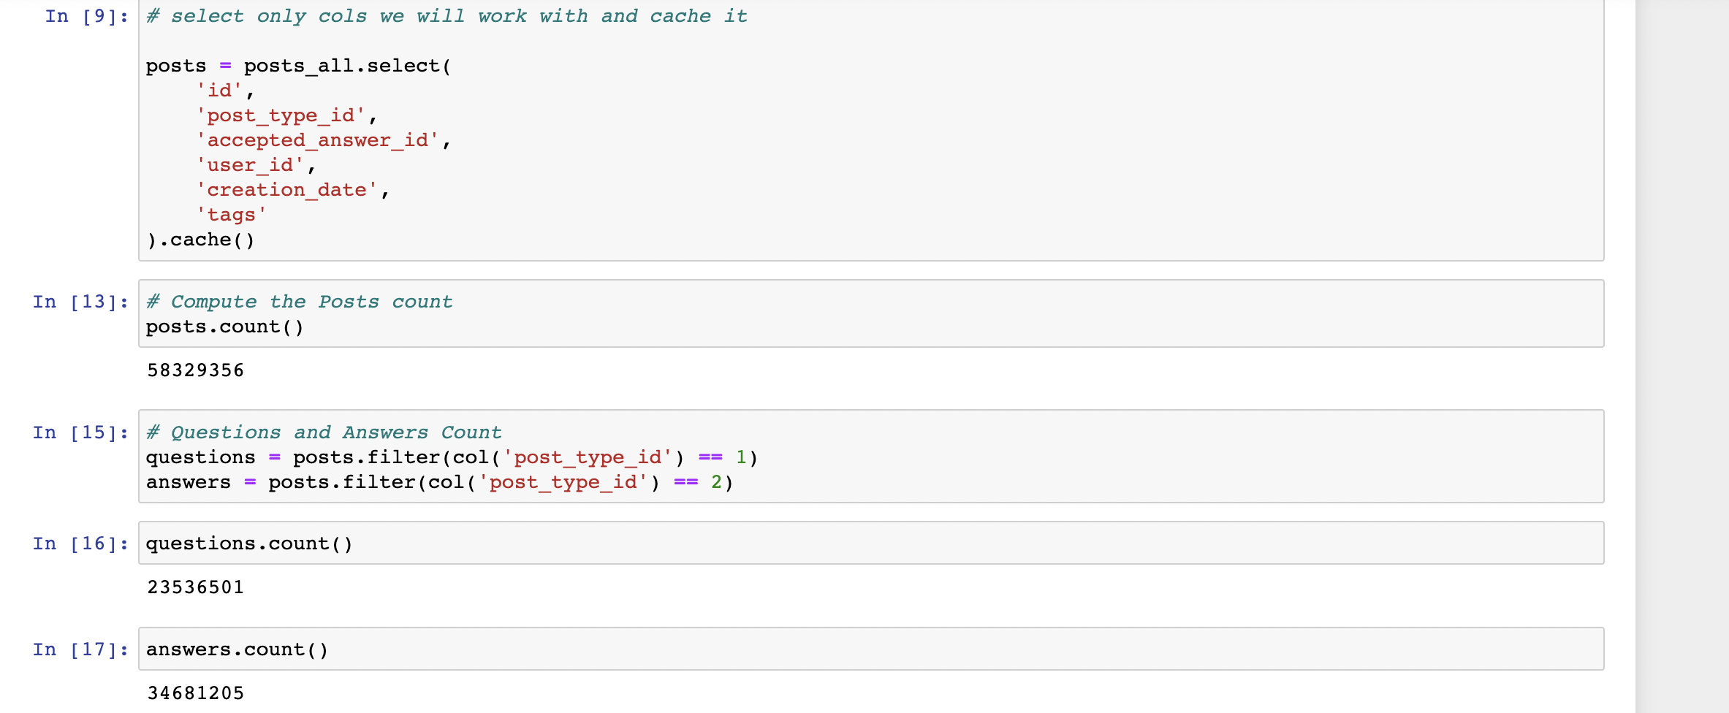
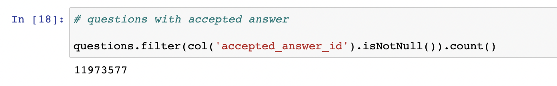
Data Analysis and Data Visualization:
Analysis on the type of posts on the Stackoverflow dataset:

Slide 20
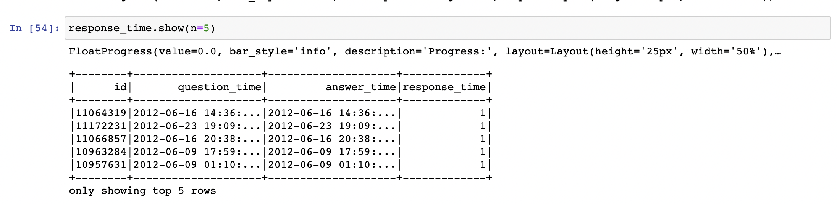
Data Analysis: Computing response time:
Difference of the question posting time and the accepted answer date time.

Slide 21
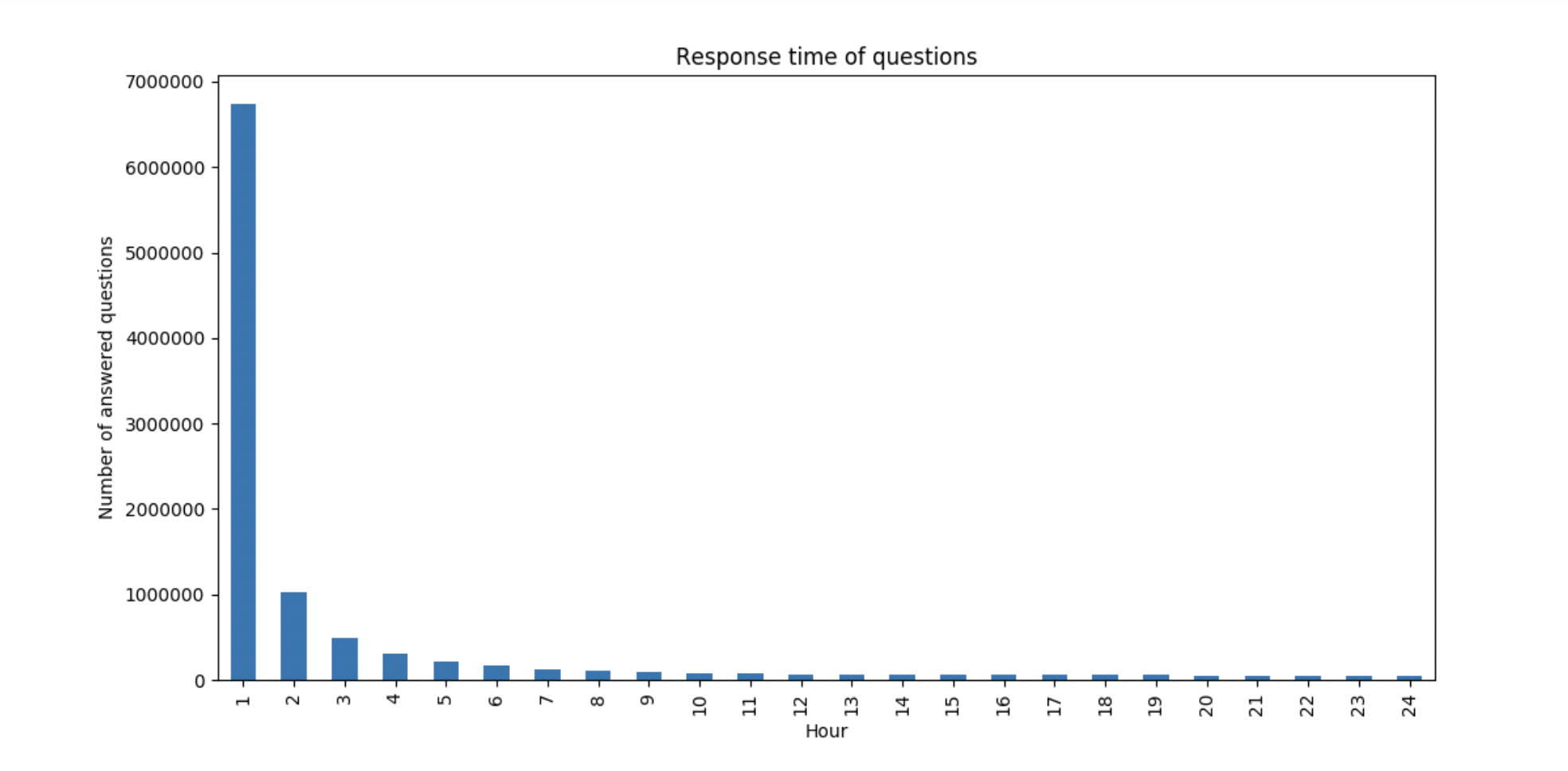
Data Analysis: Following Bar-Chart depicts the number of questions answered within each hour

Slide 22
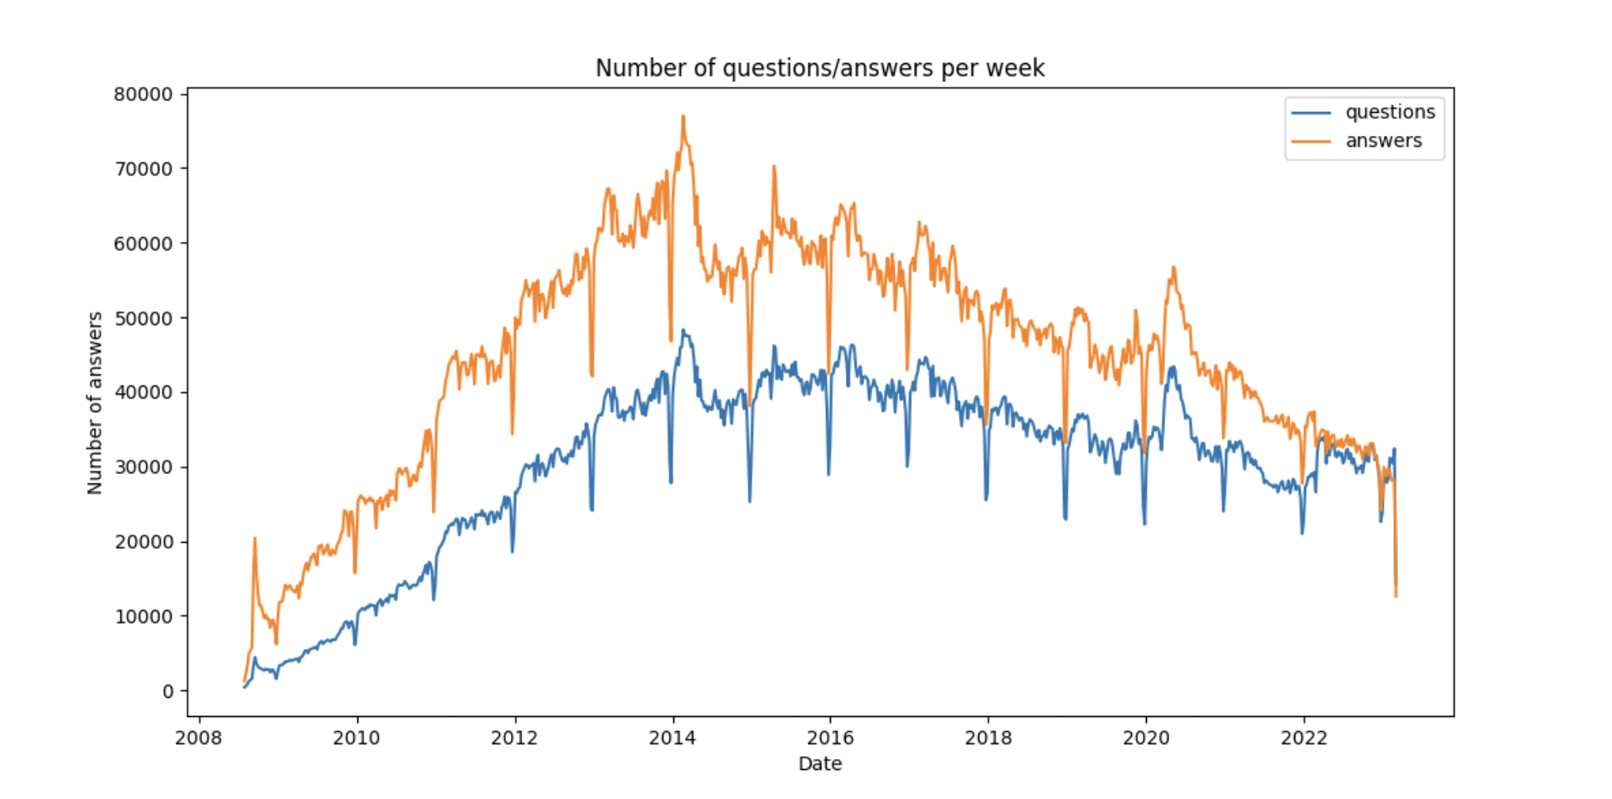
Data Analysis:
Number of Questions/Answers evolve over time: Below graph shows the trend of questions and answers over the period(2008 – 2022)

Slide 23
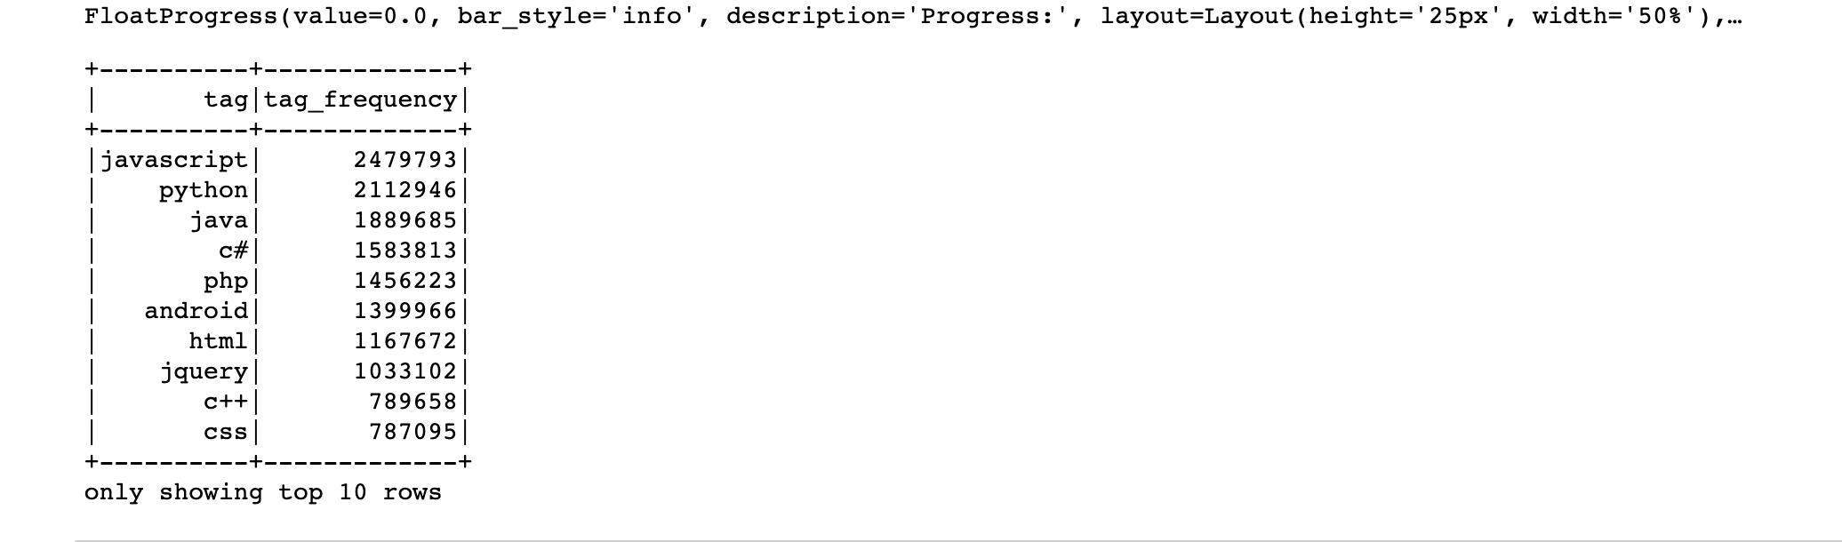
Data Analysis:
Count of number of tags:It has around 61662 tags from which below are the top 10 rows .

Slide 24
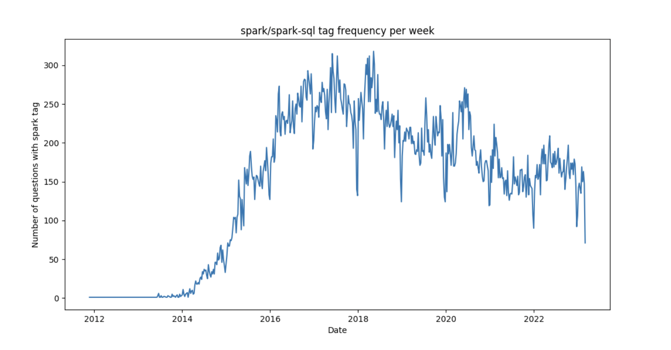
Data Analysis:
Popularity of spark/spark-sql tag over the period(2012-2022):

Slide 25
Conclusion:
The conclusion of the project is that Apache Spark and Hadoop are the powerful and efficient tool for processing and analyzing large datasets.
Using PySpark we did various analyses on the dataset, such as finding the most popular tags, and analyzing the distribution of answers and questions.
The analysis and insights obtained from the project can be useful for developers, researchers, and businesses interested in understanding the trends and patterns in the Stack Overflow community.

Slide 26
Thank You

